Slide 1
Agenda
Events in
Operating System

Slide 2
Event
In computing environment, event is an action or occurrences detected by the Program that may be handled by the program.
Typically, events are handled synchronously with the program execution flow i.e. the program has one or more dedicated places where event has been handled.
Events can be user-generated, such as keystrokes and mouse clicks, or system-generated, such as program loading, running out of memory and errors, New record inserted in database
The source of event comes from K/B or there I/O devices or any programming action which generate/focus the attention of CPU (Processing element).
Event can also use instruction set.
Event types
Interrupts
Trap
Signals

Slide 3
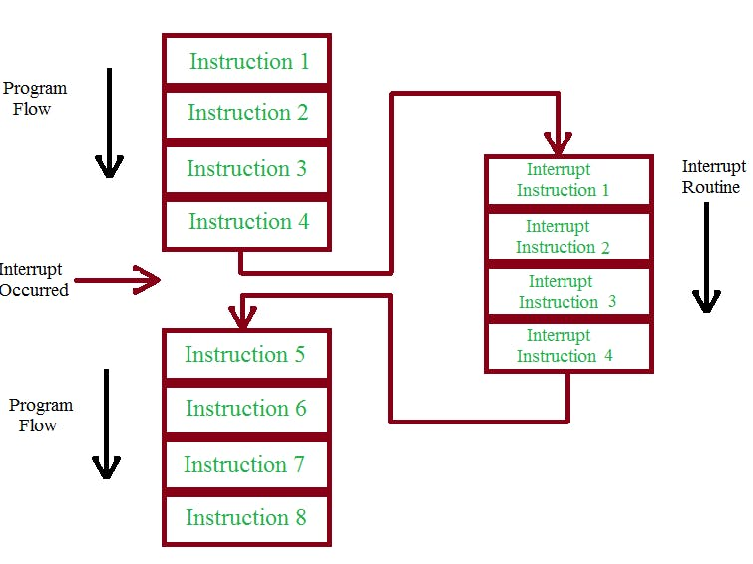
Interrupt
Interrupt is an event generated by I/O device to take attention of CPU for execution purpose.
When I/O device get hold of CPU that time the previous process contents saved into ISR (Interrupt Service Routine) where the actual location is presents.
Interrupt is a signal emitted by hardware or software when a process or an event needs immediate attention.
When we press or release a key on key board , that event is signaled up the keyboard cable to raise a hardware interrupt.

Slide 4
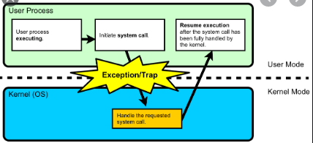
Trap
Trap is also one type of event which usually generates by the CPU itself.
CPU analyzes the processing instruction whether the instruction is execution is really fruitful or not, if not CPU generates trap and control goes to operating system,
Examples:- Divided by zero operation, there is no sense to execute this instruction that time CPU takes an action (i.e. trap) to avoid unnecessary action and control goes to OS then OS display proper message to user that error has been occurred.
Because CPU knew that divide by zero instruction is cause to waste of CPU cycle.
The process contents need not to save on ISR because there is no as such requirement of these process states in future.

Slide 5
Signal
Signal is also one type of event/interrupt send to process, which is type of soft interrupt to process.
When user want to stop the activity of any process (foreground) that time by using S/W interrupt they can control the process execution, e.g. while execution of any process the user can perform signal operation using keyboard like (Ctrl+C, Ctrl+Z,in UNIX and many more) and can control the process for a while.
When signal raised/generates that time current activity will be interrupted and signal Handler can call to handle the signal event.
In case of signal the process may takes three actions.
It takes default action defined by the O.S.
It can ignore signal.
Or, last it does specific action (programmer).
Note: On background processes signal (soft interrupt) cannot perform any action means it does not affect or stop the execution of process.

Slide 6
Thank You
We will meet Soon!!!!!!!!!!

